Slide 1

Cutting Tuition Costs by Switching to eBooks within the Rutgers Nursing School
Ian Jablonowski
Notes:
Hi, my name is Ian Jablonowski and today I’m going to be proposing a method in which Rutgers Nursing school can decrease tuition costs by switching to eBooks
- CLICK -

Slide 2
Overview
The problem with textbooks today
Measures other institutions have taken
Transitioning to eBooks within the Rutgers Nursing school
Notes:
First I am going to discuss the problem with current textbooks and justify the need for an alternative
- CLICK -
Next, I will review the measures other institutions have used to switch to eBooks
- CLICK -
Finally, I will outline my plan to for implementing eBooks within the Rutgers Nursing School
- CLICK -

Slide 3
The problem with textbooks today
Notes:
The problem with textbooks today
- CLICK -

Slide 4
An addition to tuition
Textbooks are 20% the average college tuition (Fairchild, pg. 6)
Excessive debt post graduation (“Students Call.” 2009)
Can be determining factor in attendance
Notes:
The problem with textbooks today is the large sum of money required for an education in addition to standard college tuition
Textbooks account 20% of an average 4 year college tuition
- CLICK -
Even after obtaining a degree, excessive debt often burdens students for years
- CLICK -
The extra cost of textbooks in addition to the cost of tuition can be a determining factor for students considering attending a university. Students may not attend a university because they can not afford textbook prices in addition to expensive college tuition.
- CLICK -

Slide 5
Textbook trends
Prices have tripled from 1986 to 2004 (United States, 2005)
Textbooks are chosen without regards to price (Suddath, 2008)
Textbooks are a required purchase
Notes:
The Government Accountability Office found that prices of textbooks had tripled between 1986 and 2004 along with college tuition.
- CLICK -
textbook prices are rarely disclosed to professors, textbooks are chosen without a regards to price. In reality the professor is purchasing the books, but the students are paying for them. This is referred to as a broken market.
- CLICK -
Textbooks are mandatory purchase for students. If students choose not to purchase textbooks, they will often fall behind in class. Textbooks are an essential element to a students education
- CLICK -

Slide 6
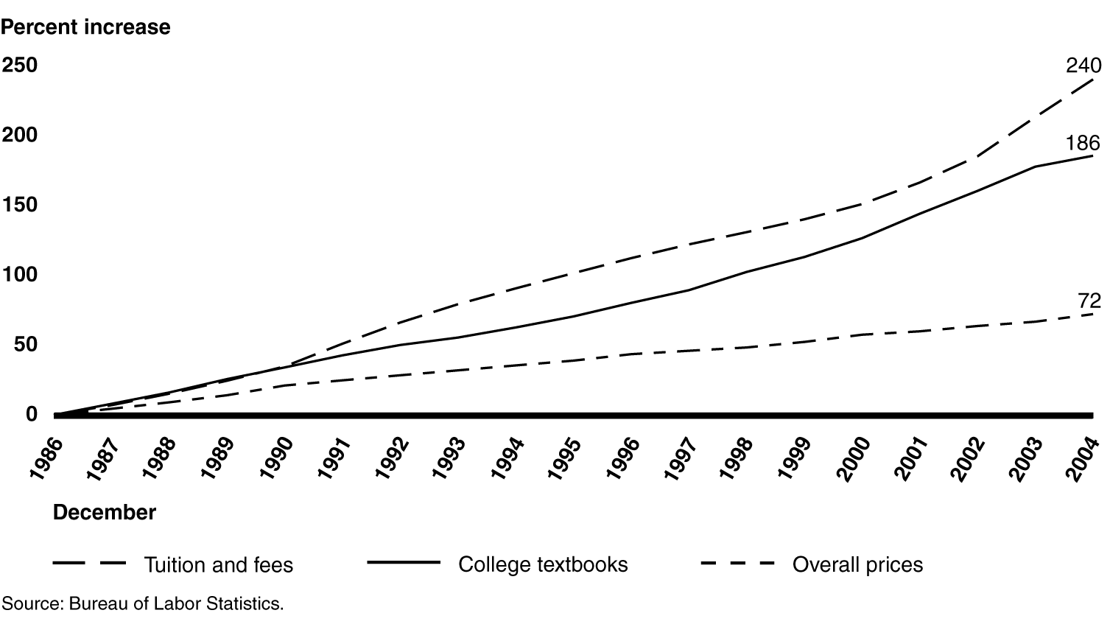
Annual Percentage Increase in College Textbook Prices, College Tuition and Fees, and Overall Price Inflation December 1986 to December 2004
(United States, 2005)
Notes:
Here we see a chart outlining the annual percentage increase in college textbook prices from 1986 to 2004. Notice the steep increase in overall price from 2002 onward
- CLICK -

Slide 7
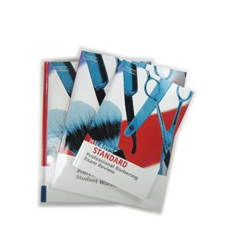
Textbook tricks
Bundling
CD ROMS
USB drives
Workbooks
Handbooks
Frequent revisions
http://www.walprice.com/index.php?main_page=index&manufacturers_id=47&sort=20a&filter_id=&alpha_filter_id=75
Notes:
Textbook companies utilize a number of methods to drive up textbook prices
- CLICK -
The first method includes bundling of materials that may not be required by professors, but are included in the purchase of a new textbook. This includes CD ROMS, use drives, workbooks and handbooks.
- CLICK -
Second, textbooks often undergo frequent revisions in an effort to limit the used book market. As new editions are required by professors each semester, the older books become outdated and worthless.
- CLICK -

Slide 8
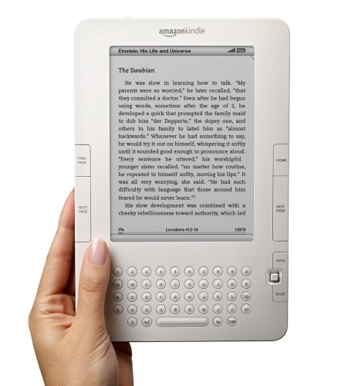
The eBook remedy
eBook
Same content as textbook
Can be read on electronic devices
Advantages
Cheaper
Digital
http://www.ebookreadersreview.co.uk/
Notes:
Enter the ebook
- CLICK -
Ebooks are essentially digital version of physical textbooks. They contain the same content as normal textbooks, including indexes, images, charts, and graphs. eBooks can be read on a variety of digital devices including computers, laptops, and specialized eBook readers.
- CLICK -
Ebooks offer special advantages. Because of a reduced production and distribution costs, eBooks can be offered at a lower price than standard textbooks. In addition, the digital format offers enhanced navigation and searching features, instant acquisition, and even support reader annotation.
- CLICK -

Slide 9
What other universities have experienced
Notes:
- CLICK -

Slide 10
Similar cases
Drexel University Medical Students distrubted iPod touches
Updated frequently (Baumeister, 2009)
Elementary schools in Florida, California, and Texas
30% of the national textbook market (Baumann, 2010)
Notes:
Over 300 nursing students attending Drexel university were distributed ipod touches to reference medical information via 5 downloadable ebooks. Ipod touches provide nurses with a huge advantage as information can be updated over the internet. In this case, students were issued updates twice a year. Textbooks require a new edition and purchase every time information is updated.
- CLICK -
The switch is not limited to just colleges. Elementery schools in Florida, California and texas intend to begin using eBooks as well. These three states account for 30% of the national text book market alone .
- CLICK -

Slide 11
Similar cases
Northwest Missouri State University
Estimated savings of $400,000 (Jessup, 2009)
North Carolina State University
School wide eBook license saved students over $250,000 (Sussman, 2010)
Notes:
Northwest Missouri state university issued students with ebook software, but required students to purchase their own ebooks. This spring they estimate they will save students more than four hundred thousand dollars.
- CLICK -
Finally, north carolina state university purchased a school wide ebook liscense for physics majors saving students over 250 thousand dollars.
- CLICK -

Slide 12
Transitioning to eBooks within the Rutgers Nursing school
Notes:
- CLICK -

Slide 13
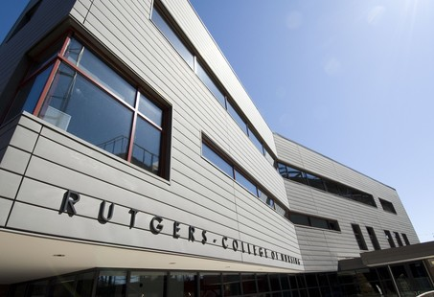
Why the Rutgers Nursing School?
Begin with small sample
Nursing students receive special benefits
eBooks already available
Updates (Baumeister, 2009)
http://www.nj.com/news/index.ssf/2009/04/rutgers_nursing_students_to_pr.html
Notes:
The Rutgers Nursing schools offers us an exciting opportunity to test this paradigm. The Nursing school is a small and separate sample who will see great benefit from the implementation of ebooks.
- CLICK -
First, nursing ebooks are already available in eBook format. In addition, medical information is updated frequently relative to other majors. eBooks allow nurses to stay up to date with the latest medical information.
Universities like drexel have already proven that the switch is beneficial to students.

Slide 14
The plan
Require all class texts are available in eBook format
Ensure that all students are capable of reading eBooks
Loan eBook readers to 20% of students (Young, 2009)
Notes:
In order to ensure the switch to ebooks goes smoothly, we must require that all class texts are available in eBook format.
- CLICK -
In addition, we must ensure that all students are capeable of reading ebooks. According to a survey by Educause, less than 20% of college students do not own any device capable of displaying eBooks. We will loan readers to this percentage of students to ensure that all students have the ability to read ebooks.
- CLICK -

Slide 15
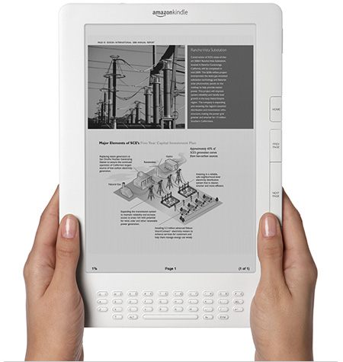
The device
Loan out Amazon Kindle 2
High ratings
Cheap (Arar, 2009)
http://news.cnet.com/8301-17938_105-10234355-1.html
Notes:
I have selected the Amazon Kindle 2 as the eBook reader of choice. It is the most balanced device in regards to user rating and price. The Amazon Kindle 2 is the second version of the Amazon kindle. It supports downloading ebooks over WIFI, annotations, and a paper like display.
- CLICK -

Slide 16
The price
Estimated 50 nursing students without ability to read eBooks (Chambers, 2009)
One Amazon Kindle 2 is $260 (Arar, 2009)
Estimated price: $13,000
Notes:
The price of implementation is fairly cheap. An estimated 50 nursing students will require an eBook reader. At 260 dollars a device, the estimated cost of this plan totals to 13 thousand dollars.
- CLICK -

Slide 17
Summary
Tuition costs are continually increasing
eBooks offer an alternative to the high cost of textbooks
Decrease student debt
Can be extended to entire university
Notes:
Tuition costs are continually inreasing, and they do not show signs of easing.
- CLICK -
Textbooks are a high cost on top of tuition – ebooks offer a cheaper alternative to high textbook prices.
- CLICK -
With the implementation of ebooks, we can decrease student debt and encourage enrollment for the future.
- CLICK -
If all goes well, this plan can be extended throughout all of Rutgers university.
- CLICK -

Slide 18
An Invitation
Ian Jablonowski
ianjablonowski@eden.rutgers.edu
Thank you for your time

